Slide 1
Predicting Home Prices

Slide 2
The Problem Statement
Housing prices have skyrocketed to all time highs in most recent years, is that a good thing?
What is causing this and why?
Are we destined to repeat the 2007 housing market crash? Or is it different this time around?
As Mayor, we wish to study the real factors driving these record home prices to see if they are caused by short term inputs such as the current state of interest rates or even the price of lumber. We will decide on our investments based on future prediction of these home prices

Slide 3
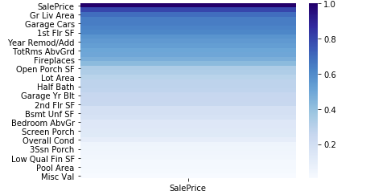
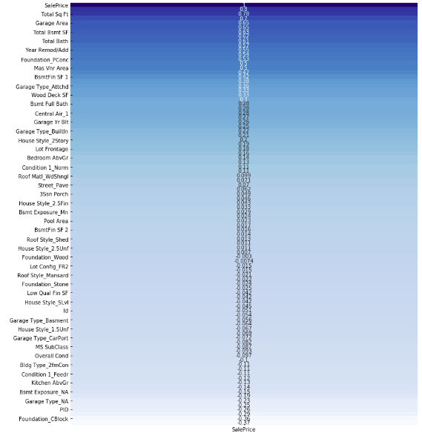
Data- Ames Housing Variables vs Price
Identify variables
Create model
Check Accuracy

Slide 4
Sales Price Correlation Heatmap

Slide 5
-Looking at the correlation heatmaps, we can determine and test the factors most likely to impact the Sales Price.
-In this example, Square footage(total), number rooms/bathrooms, upgraded amenities, quality and add-ons such as AC, Garages and fireplaces have shown to have the most significant impact.
Conclusion

Slide 6
Recommendations
-Normal predictors for home prices show the market is being impacted by other factors.
-Factors such as tax rates, stimulus packages, limited supply and the pandemic have exacerbated the underlying issue. While these factors differ from the 2007-8 Housing crash, similarities are obvious…. But more research is needed.

Slide 7
More Research
While we gained some valuable information, there is still a lot deeper we can dive into regarding price impact in the Housing Market.
What are some of the other socio economic factors that impact housing prices?
What are some controllable factors for Mayor Kang that impact housing prices?

